Slide 1
Evacuation Model for Interior Layout Evaluation
Yon-Chien Huang (Yvonne)
Geo503 Spatial simulation, spring 2022

Slide 2
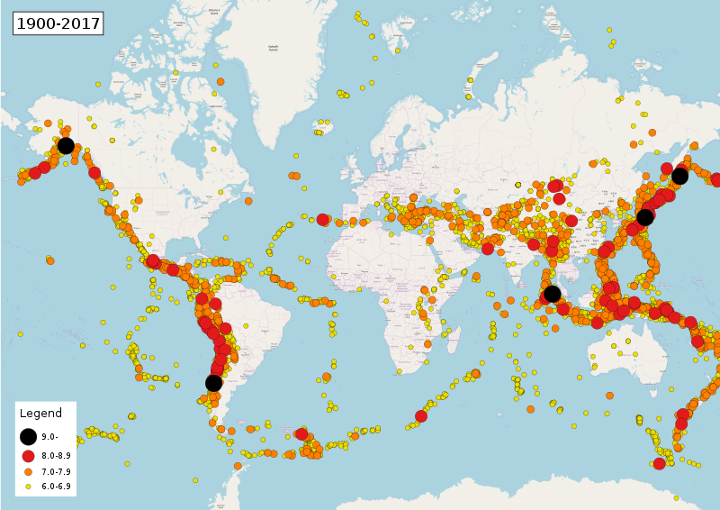
Introduction
Earthquake
1999, Jiji, Taiwan. 2,415 deaths
2008, Sichuan, China, 69,000 deaths
2010, Haiti, 220,000 deaths
2011, Tōhoku, Japan, 19,747 deaths
2019, Ridgecrest, Calfornia, US

Slide 3
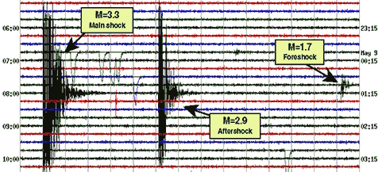
Introduction
Evacuation
Escape before earthquake with larger magnitude
Foreshock happen minutes or days before mainshock
Aftershock happen minutes or days after mainshock
Minimize evacuation time
Interior layout (floorplan) affect evacuation process

Slide 4
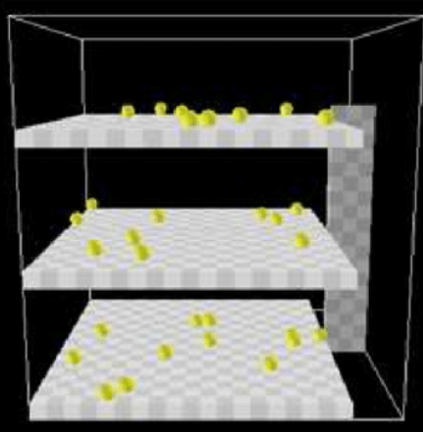
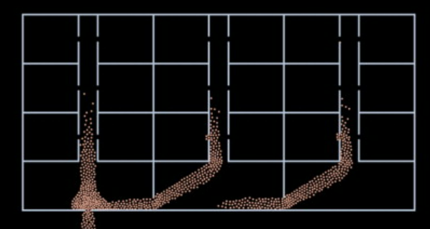
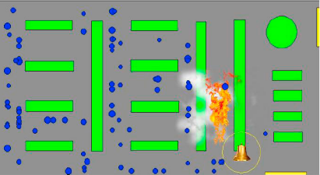
Background—previous research
Evacuation models
The simulation of evacuation from multistorey building using NetLogo. D P Lestari (2020)
Agent-based modeling of a multi-room multi-floor building emergency evacuation. Vi Ha, George Lykotrafitis (2012)
Agent-Based Modelling and Simulation for evacuation of people from a building in case of fire. Selain Kasereka. etc. (2018)
Fixed environment!

Slide 5
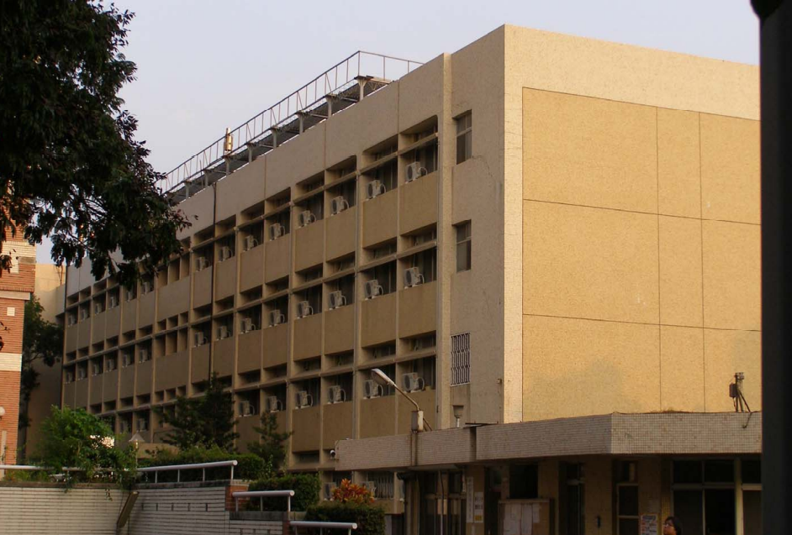
Background—Study Area
Environment
Student hall in National Cheng Kung University, Taiwan
3 story building
14 room each floor
Stairway width only allow one agent to pass
Agents
Residents of student hall
Walk 1 m per second

Slide 6
Model Design
Research Question
How the size of exits and stairs (interior layout) affect evacuation time and process?
How long is the evacuation time in different capacity?

Slide 7
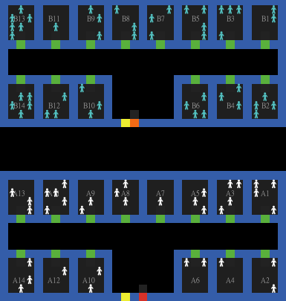
Methodology
Start
Goal
Exit and stairs
Face to the goal
Front grid occupied?
no
yes
Move forward
Turn left or right
Front grid occupied?
no
Arrived goal?
no
yes
yes
Stay
Leave simulation

Slide 8
Scenarios
Scenario 1
Exit and stairs width = 1
Half capacity, 28 people per floor
Scenario 2
Exit and stairs width = 2
Half capacity, 28 people per floor
Each scenario was run 10 times
Scenario 3
Exit and stairs width = 1
Full capacity, 56 people per floor
Scenario 4
Exit and stairs width = 1
Full capacity, 56 people per floor

Slide 9
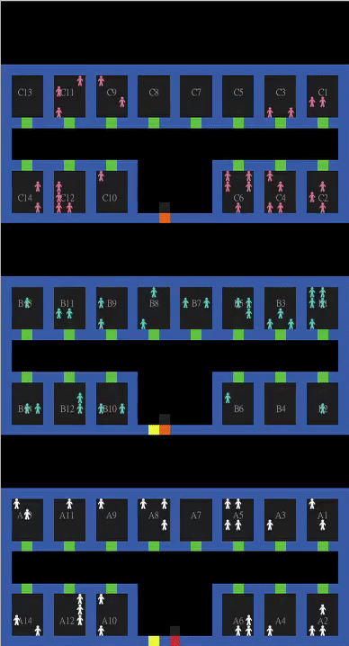
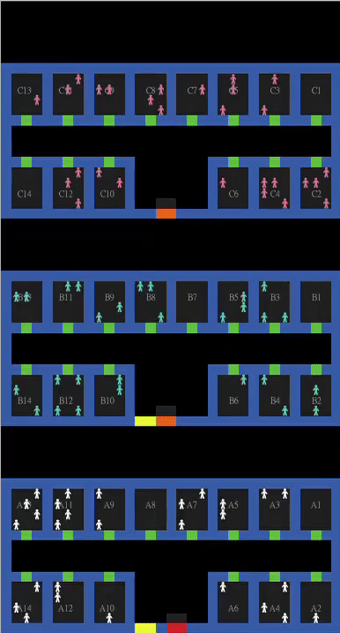
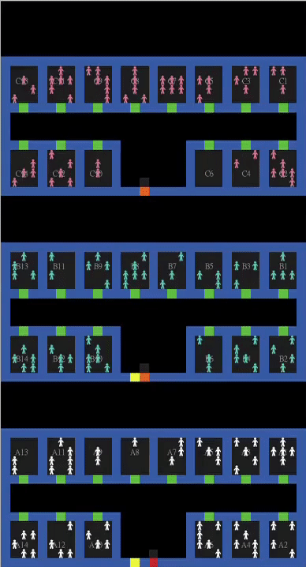
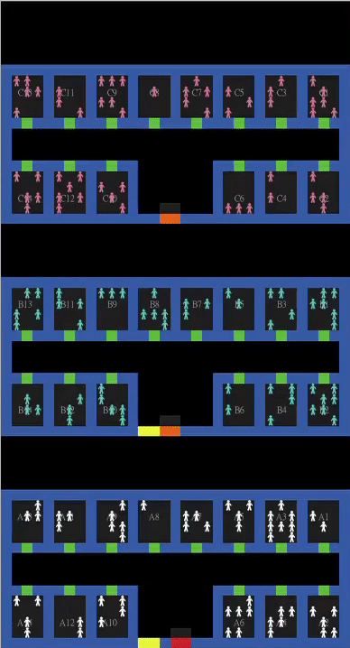
Results
Scenario 1 | Scenario 2 | Scenario 3 | Scenario 4

Slide 10


Results
Scenario 1 | Scenario 2 | Scenario 3 | Scenario 4

Slide 11

Verification and Validation
Verification
Evacuation time is reduced by widening the stairs
Time reduction is more obvious when full capacity
Agents crowded nearby the exits and stairs
Validation
Residents evacuate in 5 minutes
Lecture of evacuation rehearsal, NCKU, 2017

Slide 12
Conclusion and Discussion
Results
Correspond to expectations
Evacuation time decrease when exits are widened
More significant with more agents (half capacity: 10.1 ticks; full capacity: 23.9 ticks)
Improvement
Model Behavior
Agents do not walk in the same speed
Panic (controversial)
Validation
Lack of information: What is the appropriate time cost limitation to finish evacuation

Slide 13
Question?

